Slide 1
A Walk in Their Shoes
One Size Does Not Fit All
Deborah R. Barnett, Ph.D.
Southern Illinois University Carbondale

Slide 2
Education B.S. Business Administration M.S. Education: Workforce Education and Development Ph.D. Education: Workforce Education and Development Professional Experiences Assistant Dean of Students: Adult, Veteran, and Family Services Provost Assessment Fellow Coordinator, Non-Traditional Student Services Trainer: John A. Logan College Center for Business and Industry Business Owner Publications Telling a Compelling Story with DATA: Assessment of Adult Learner Programs Academic and Social Integration of Nontraditional Students Devalued, Misunderstood, and Marginalized: Adult Student Experiences Cutting Edge Technology in the Learning Environment The Adult Learner Focused Institution: A Review of Midwestern Institutions Partnering Industry and Education for Curricular Enhancement Adult Education: Motivation and Recruitment of Working Adults in the Pursuit of Higher Ed Post-Traditional Student Returned to college in mid-30s to complete bachelor’s degree.
Deborah R. Barnett, Ph.D.
Southern Illinois University Carbondale

Slide 3
AGENDA
Overview of Study
Introduction of 10 Adult Learners
Review of Themes
Transitions, Early Successes, Acceptance, Developing Student Identity
Single Common Denominator of Student Persistence
Implications and Discussion
A Walk in Their Shoes: One Size Does Not Fit All

Slide 4
Background
2010-2021 Projections¹
Students age 25-34 (20% increase)
Students age 35+ (25% increase)
Traditional student population (10%)
Non-degree holding Americans (18-55)²
23% seek to further education within 2 years
Studies indicate population at risk for non-completion^{3,4}
Enrollment is just the beginning!
A Walk in Their Shoes: One Size Does Not Fit All

Slide 5
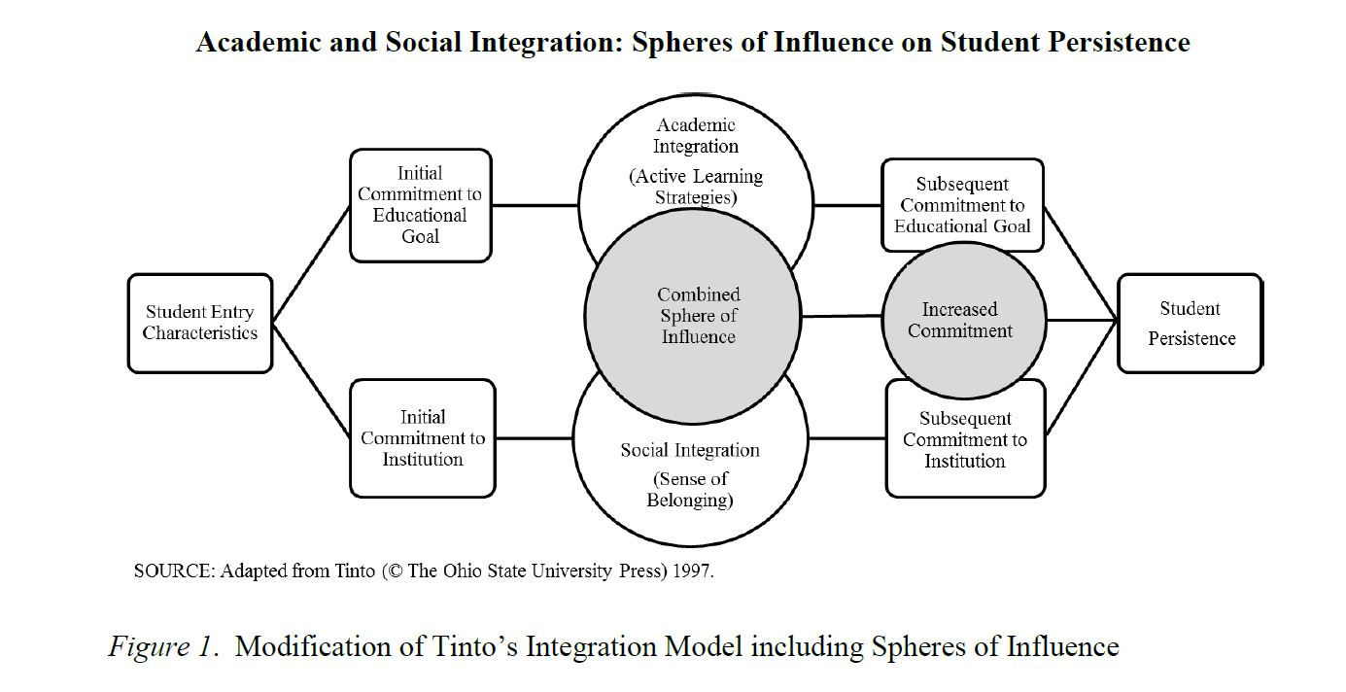
Study Overview
Tinto’s Integration Theory^{5,6}
A Walk in Their Shoes: One Size Does Not Fit All

Slide 6
Study Overview
Nontraditional student: Students who have one or more of the following characteristics: delayed enrollment, part-time enrollment, full-time employment, financially independent, and family commitments (NCES, 2002).
For the purpose of this study, nontraditional is specifically defined as age 25 and over or age 18-24 (married and/or with dependents).
4-year, public, research institution
Mixed Methods: Survey and Focus Groups
A Walk in Their Shoes: One Size Does Not Fit All

Slide 7
Meeting the Adult Learners
A Walk in Their Shoes: One Size Does Not Fit All

Slide 8
Themes
Tinto’s model served as broad theoretical categories to guide thematic placement.
Thematic categories and sub-themes derived from verbatim transcription of focus group interviews.
Constant comparison analysis used to code passages and compare codes for categorization.
A Walk in Their Shoes: One Size Does Not Fit All

Slide 9
Transitions
Student Entry Characteristics
Some college, no degree
Purposeful, intentional decision to return to college (here for a purpose)
Very different than Tinto’s model which identifies race, gender, GPA, etc. as significant predictors of traditional student persistence.
Initial Commitment to Educational Goal
Determined to finish
Initial Commitment to Institution
Primary reasons for institutional choice
Location (Place bound)
Support Services
A Walk in Their Shoes: One Size Does Not Fit All

Slide 10
Early Successes
Academic Integration
Can I do it?
“I did very well right in the beginning and that motivated me, that made me feel like, yeah I can do this! Even though I’m older coming back, I can still, I can hang with these guys, I can still do this.”
~Bob
A Walk in Their Shoes: One Size Does Not Fit All

Slide 11
Acceptance
Social Integration
Feeling different
In class, I’m just a student
Everybody needs somebody
“I don’t know if I feel fully accepted in the classroom because I don’t know if I go there to BE accepted, I go there to learn. But, then I don’t feel completely isolated either. ~Lauren
“I wasn’t going to blend, but to do that as much as possible and to BE a student, just be a student” was the goal Jane set for herself
A Walk in Their Shoes: One Size Does Not Fit All

Slide 12
Belonging is Academic
Academic-Focused Socialization
Classroom is primary site of social integration
“I feel so out of place, but as far as like the educational-wise, I feel a part of the classroom. I’ve made plenty of friends with professors and students and I feel like I’m part of [the institution].” ~Steve
Lauren, Grammy, Faith, and Bob developed friendships with classmates through assignments, going to the computer lab, or talking about career goals.
A Walk in Their Shoes: One Size Does Not Fit All

Slide 13
Developing Student Identity
Integration described as the point in which academic purpose was clear.
Integration is “not exactly a feeling, it’s a KNOWING situation” of being committed to an academic direction. ~Steve
Arthmis shared that, when she enrolled in college just out of high school, she was missing PURPOSE. As a returning adult, she felt integrated when she discovered her academic goal and purpose. Faculty and staff were important in that discovery.
A Walk in Their Shoes: One Size Does Not Fit All

Slide 14
Persistence Factor
Definitely finishing!
“I’m here for my degree…and I’m here to do well!” ~Jane
“There may be a day ‘why am I doing this?’, but we all have days like that and we just continue on.” ~George
“I’m here for a purpose, and I can’t allow anyone to take that from me!” ~Arthmis
A Walk in Their Shoes: One Size Does Not Fit All

Slide 15
Persistence Factor
Single greatest predictor of persistence…
INITIAL COMMITMENT
TO THE EDUCATIONAL GOAL
Seemed to transcend any influence that race, gender, parent’s educational attainment, dependent status, marital status, employment status, or previous GPA might have on predicting nontraditional student persistence.
A Walk in Their Shoes: One Size Does Not Fit All

Slide 16
Implications
Nontraditional students tend to have a high commitment to degree completion and, therefore, persistence.
For many, bachelor’s degree is just the beginning (implications for graduate schools)
Academic integration (active learning strategies) seems to influence satisfaction, but not persistence.
Social integration or belonging is important, but tends to be academically-focused not purely social.
Integration occurred in the classroom, but seemed to relate more to student identity development.
A Walk in Their Shoes: One Size Does Not Fit All

Slide 17
Recommendations for Practice
Prioritize pre-entry/early transition assistance
Clarify or strengthen educational goal commitment
Develop strong understanding of academic purpose and student identity
Minimize barriers related to institutional processes, resource identification, and financial aid concerns
Provide pre-entry student counseling that emphasizes importance of a support system (everybody needs somebody)
Ongoing support
Focus on the goal!
A Walk in Their Shoes: One Size Does Not Fit All

Slide 18
Questions and Discussion
A Walk in Their Shoes: One Size Does Not Fit All

Slide 19
References
Hussar, W. J., & Bailey, T. M. (2013). Projections of education statistics to 2021 (NCES 2013-008). Washington, DC: U.S. Department of Education, National Center for Education Statistics.
Hagelskamp, C., Schleifer, D., & DiStasi, C. (2013, November). Is college worth it for me? How adults without degrees think about going (back) to school. New York, NY: Public Agenda. Retrieved from http://www.publicagenda.org/files/IscollegeWorthItForMe_PublicAgenda_2013.pdf
Flint, T. A. (2005). How well are we serving our adult learners? Investigating the impact of institutions on success & retention. Chicago, IL: Council for Adult and Experiential Learning. Retrieved from http://www.inpathways.net/reenrollment_study.pdf
National Center for Education Statistics. (1996). Nontraditional undergraduates: Trends in enrollment from 1986 to 1992 and persistence and attainment among 1989-90 beginning postsecondary students. U.S. Department of Education. NCES 97-578. Retrieved from http://nces.ed.gov/pubx/we/97578.asp
Tinto, V. (1997, November/December). Classrooms as communities: Exploring the educational character of student persistence. The Journal of Higher Education, 68(6), 599-623).
Tinto, V. (2012). Completing college: Rethinking institutional action. Chicago, IL: The University of Chicago Press.
NOTE: The presentation’s findings including focus group demographics, student interview statements, etc. can be found in the complete study. Barnett, D. R. (2014). Academic and Social Integration of Nontraditional Students: The Role of Active Learning Strategies and Sense of Belonging in Integration and Persistence. http://opensiuc.lib.siu.edu/dissertations/936/
A Walk in Their Shoes: One Size Does Not Fit All

